Slide 1

Introduction to Probabilistic Machine Learning
Ralf Herbrich, Rainer Schlosser
Tutorial 5 – Recap Theory Unit 5

Slide 2
Overview
Questions and Updates
Recap: Main Concepts of Unit 5
Example: KL Divergence
Example: Iterating Approximated Factors
Example: Normalization Constant

Slide 3
Course Overview
Week | Topic Lecture | Tutorial | Exercises
07.04. & 08.04. | 1 Probability Theory | Intro Julia
14.04. & 15.04. | 2 Inference Methods and Decision-Making | no tutorial | Exercise 1
21.04. & 22.04. | no lecture | Theory Unit 1 & 2 | (14.04. – 08.05.)
28.04. & 29.04. | 3 Graphical Models: Independence | Theory Unit 3
05.05. & 06.05. | 4 Graphical Models: Exact Inference | Theory Unit 4 | Exercise 2
12.05. & 13.05. | 5 Graphical Models: Approximate Inference | Theory Unit 5 | (05.05. – 19.05.)
19.05. & 20.05. | 6 Bayesian Ranking | Theory Unit 6 | Exercise 3
26.05. & 27.05. | 7 Linear Basis Function Models | Theory Unit 7 | (19.05. – 02.06.)
02.06. & 03.06. | 8 Bayesian Regression | Theory Unit 8 | Exercise 4
09.06. & 10.06. | no lecture | 9 Bayesian Classification | (02.06. – 23.06.)
16.06. & 17.06. | 10 Non-Bayesian Classification Learning | Theory Unit 9 & 10
23.06. & 24.06. | 11 Gaussian Processes | Theory Unit 11 | Exercise 5
30.06. & 01.07. | 12 Information Theory | Theory Unit 12 | (23.06. – 07.07.)
07.07. & 08.07. | 13 Real-World Applications

Slide 4
Overview
Questions and Updates
Recap: Main Concepts of Unit 5
Example: KL Divergence
Example: Iterating Approximated Factors
Example: Normalization Constant

Slide 5
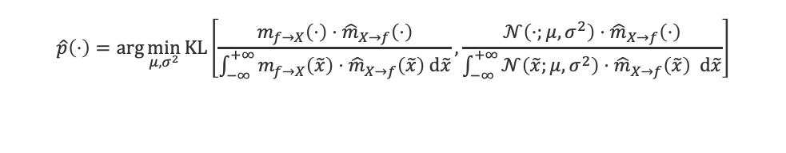
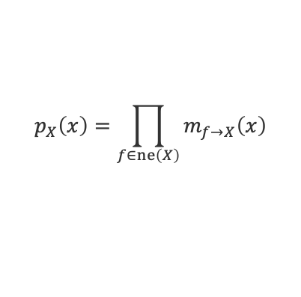
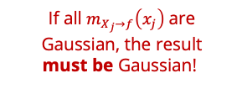
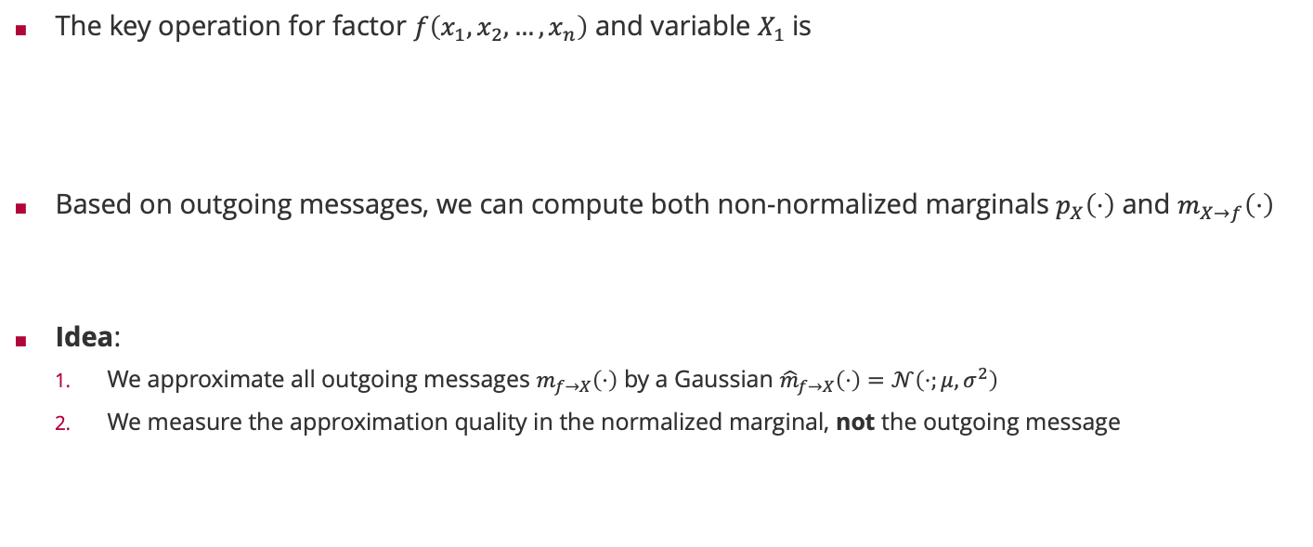
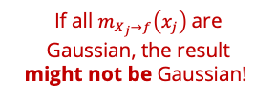

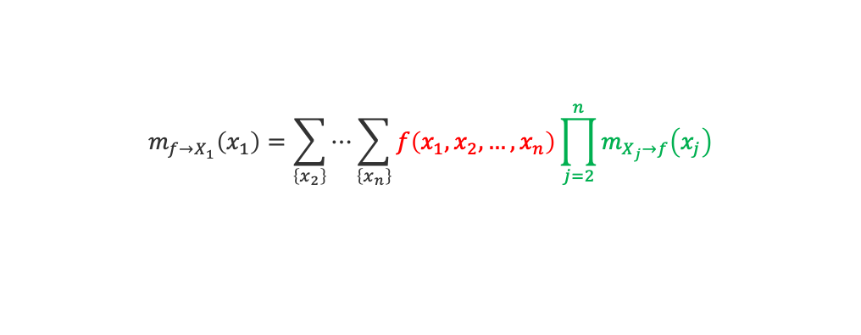
Sum-Product Algorithm Revisited
The key operation for factor $f\left(x_{1},x_{2},…,x_{n}\right)$ and variable $X_{1}$is
Based on outgoing messages, we can compute both non-normalized marginals $p_{X}\left(⋅\right)$ and $m_{X→f}\left(⋅\right)$
Idea:
We approximate all outgoing messages $m_{f→X}\left(⋅\right)$ by a Gaussian ${\hat{m}}_{f→X}\left(⋅\right)=𝒩\left(⋅;μ,σ^{2}\right)$
We measure the approximation quality in the normalized marginal, not the outgoing message
$$m_{f→X_{1}}\left(x_{1}\right)=\sum_{\left\{x_{2}\right\}}{⋯\sum_{\left\{x_{n}\right\}}{f\left(x_{1},x_{2},…,x_{n}\right)\prod_{j=2}^{n}{m_{X_{j}→f}\left(x_{j}\right)}}}$$
If all $m_{X_{j}→f}\left(x_{j}\right)$are Gaussian, the result might not be Gaussian!
$$p_{X}\left(x\right)=\prod_{f∈ne\left(X\right)}{m_{f→X}\left(x\right)}$$
$$m_{X→f}\left(x\right)=\frac{p_{X}\left(x\right)}{m_{f→X}\left(x\right)}$$
If all $m_{X_{j}→f}\left(x_{j}\right)$are Gaussian, the result must be Gaussian!
$$\hat{p}\left(⋅\right)=\arg{\min_{μ,σ^{2}}{KL\left[\frac{m_{f→X}\left(⋅\right)⋅{\hat{m}}_{X→f}\left(⋅\right)}{\int_{−∞}^{+∞}{m_{f→X}\left(\tilde{x}\right)⋅{\hat{m}}_{X→f}\left(\tilde{x}\right) d\tilde{x}}}, \frac{{𝒩\left(⋅;μ,σ^{2}\right)⋅\hat{m}}_{X→f}\left(⋅\right)}{\int_{−∞}^{+∞}{{𝒩\left(\tilde{x};μ,σ^{2}\right)⋅\hat{m}}_{X→f}\left(\tilde{x}\right) d\tilde{x}}}\right]}}$$
True normalized marginal with approximate incoming message
Approximate marginal with approximate incoming message

Slide 6
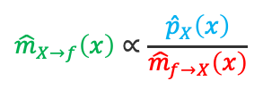
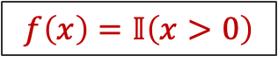
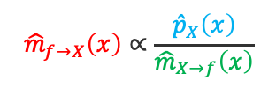
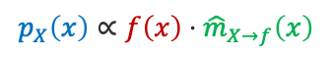
Approximate Message Passing: Example
$$f\left(x\right)=𝕀\left(x>0\right)$$
$${\hat{m}}_{X→f}\left(x\right)∝\frac{{\hat{p}}_{X}\left(x\right)}{{\hat{m}}_{f→X}\left(x\right)}$$
$${\hat{m}}_{f→X}\left(x\right)∝\frac{{\hat{p}}_{X}\left(x\right)}{{\hat{m}}_{X→f}\left(x\right)}$$
$$p_{X}\left(x\right)∝f\left(x\right)⋅{\hat{m}}_{X→f}\left(x\right)$$
$${\hat{p}}_{X}\left(x\right)=𝒩\left(x;E_{X∼p_{X}}\left[X\right],{var}_{X∼p_{X}}\left[X\right] \right)$$

Slide 7
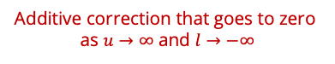
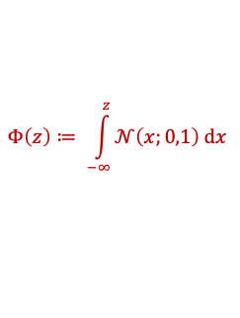
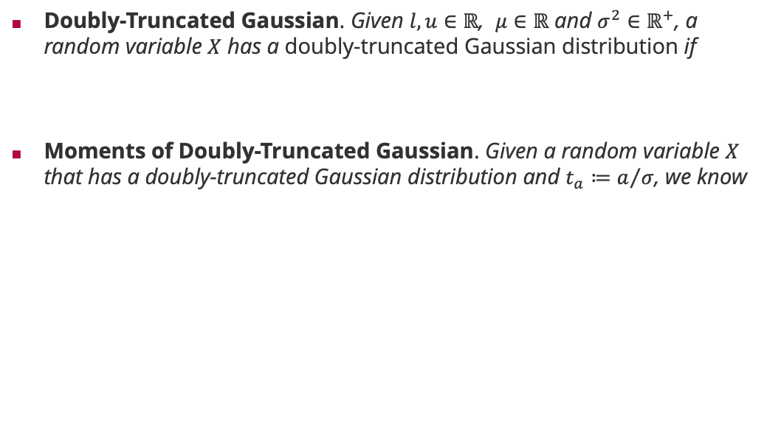
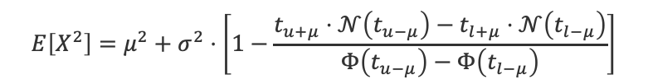
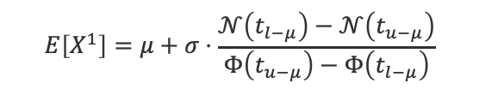


Generalization: Doubly-Truncated Gaussians
Doubly-Truncated Gaussian. Given $l,u∈ℝ$, $μ∈ℝ$ and $σ^{2}∈ℝ^{+}$, a random variable $X$ has a doubly-truncated Gaussian distribution if
Moments of Doubly-Truncated Gaussian. Given a random variable $X$ that has a doubly-truncated Gaussian distribution and $t_{a}≔a/σ$, we know
$$p_{X}\left(x\right)∝𝕀\left(l<x<u\right)⋅𝒩\left(x;μ,σ^{2}\right)$$
$$Φ\left(z\right)≔ \int_{−∞}^{z}{𝒩\left(x;0,1\right) dx}$$
$$E\left[X^{0}\right]=Φ\left(t_{u−μ}\right)−Φ\left(t_{l−μ}\right)$$
$$E\left[X^{1}\right]=μ+σ⋅\frac{𝒩\left(t_{l−μ}\right)−𝒩\left(t_{u−μ}\right)}{Φ\left(t_{u−μ}\right)−Φ\left(t_{l−μ}\right)}$$
Additive correction that goes to zero as $u→∞$ and $l→−∞$
$$E\left[X^{2}\right]=μ^{2}+σ^{2}⋅\left[1−\frac{t_{u+μ}⋅𝒩\left(t_{u−μ}\right)−t_{l+μ}⋅𝒩\left(t_{l−μ}\right)}{Φ\left(t_{u−μ}\right)−Φ\left(t_{l−μ}\right)}\right]$$
Multiplicative correction that goes to one as $u→∞$ and $l→−∞$

Slide 8
Overview
Questions and Updates
Recap: Main Concepts of Unit 5
Example: KL Divergence
Example: Iterating Approximated Factors
Example: Normalization Constant

Slide 9
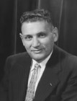
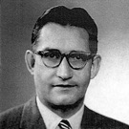
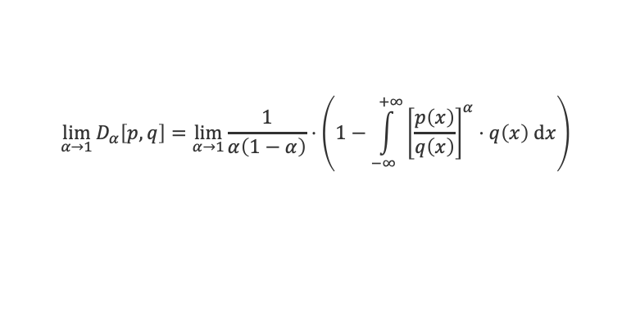
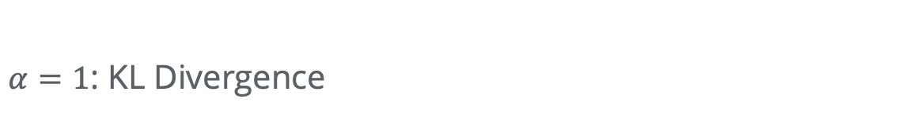
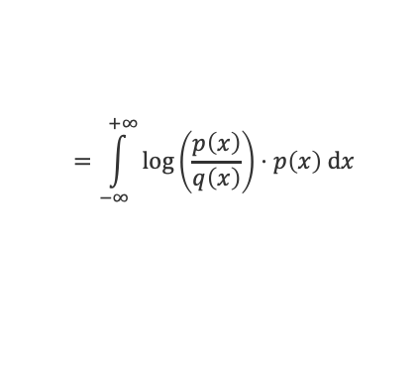
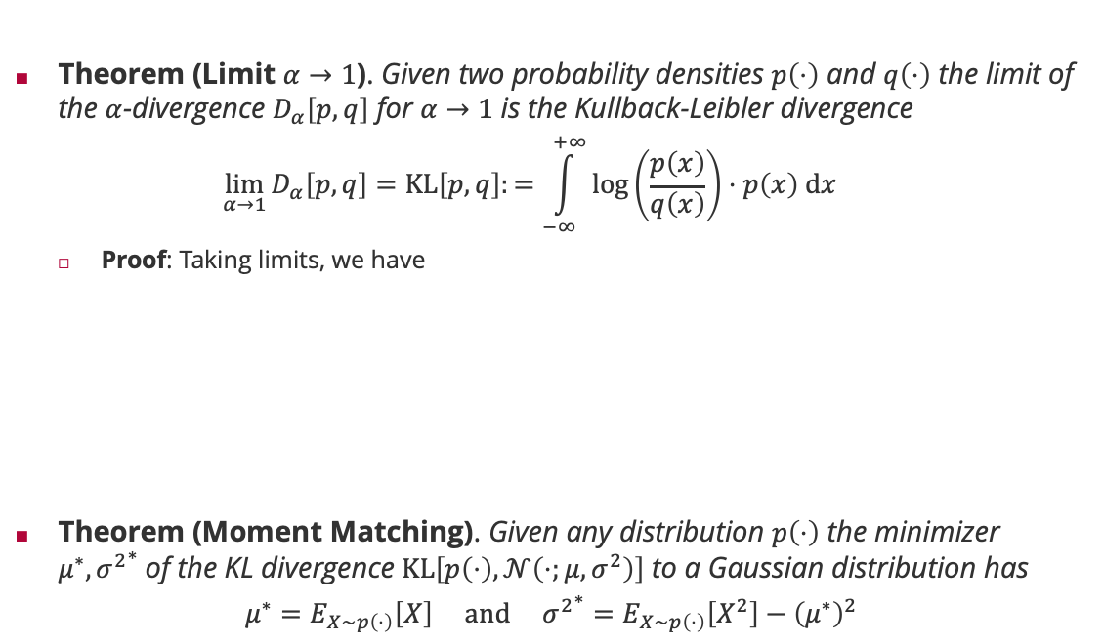
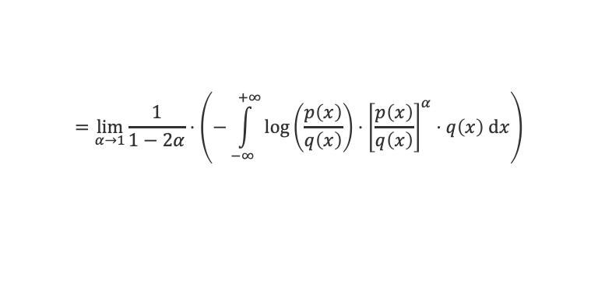
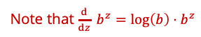
$α=1$: KL Divergence
Theorem (Limit $α→1$). Given two probability densities $p\left(⋅\right)$ and $q\left(⋅\right)$ the limit of the $α$-divergence $D_{α}\left[p,q\right]$ for $α→1$ is the Kullback-Leibler divergence
$$\lim_{α→1}{D_{α}\left[p,q\right]}=KL\left[p,q\right]:=\int_{−∞}^{+∞}{\log\left(\frac{p\left(x\right)}{q\left(x\right)}\right)⋅p\left(x\right) dx}$$
Proof: Taking limits, we have
Theorem (Moment Matching). Given any distribution $p\left(⋅\right)$ the minimizer $μ^{∗},{σ^{2}}^{∗}$of the KL divergence $KL\left[p\left(⋅\right),𝒩\left(⋅;μ,σ^{2}\right)\right]$ to a Gaussian distribution has
$$μ^{∗}=E_{X∼p\left(⋅\right)}\left[X\right] and {σ^{2}}^{∗}=E_{X∼p\left(⋅\right)}\left[X^{2}\right]−{\left(μ^{∗}\right)}^{2}$$
Solomon Kullback (1909 – 1994)
$$\lim_{α→1}{D_{α}\left[p,q\right]}=\lim_{α→1}{\frac{1}{α\left(1−α\right)}⋅\left(1−\int_{−∞}^{+∞}{{\left[\frac{p\left(x\right)}{q\left(x\right)}\right]}^{α}⋅q\left(x\right) dx}\right)}$$
L'Hôpital's rule!
Note that $\frac{d}{dz} b^{z}=\log\left(b\right)⋅b^{z}$
$$=\lim_{α→1}{\frac{1}{1−2α}⋅\left(−\int_{−∞}^{+∞}{{\log\left(\frac{p\left(x\right)}{q\left(x\right)}\right)⋅\left[\frac{p\left(x\right)}{q\left(x\right)}\right]}^{α}⋅q\left(x\right) dx}\right)}$$
Richard Leibler (1914 – 2003)
$$=\int_{−∞}^{+∞}{\log\left(\frac{p\left(x\right)}{q\left(x\right)}\right)⋅p\left(x\right) dx}$$

Slide 10
KL Divergence & Alternatives
Question: What is the difference between two (discrete) distributions?
Ideas??

Slide 11
KL Divergence & Alternatives
Question: What is the difference between two (discrete) distributions?
Ideas??
Candidates: MSE RMSE MAE MAPE KL
Pros & Cons?

Slide 12
Overview
Questions and Updates
Recap: Main Concepts of Unit 5
Example: KL Divergence
Example: Iterating Approximated Factors
Example: Normalization Constant

Slide 13

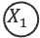
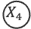
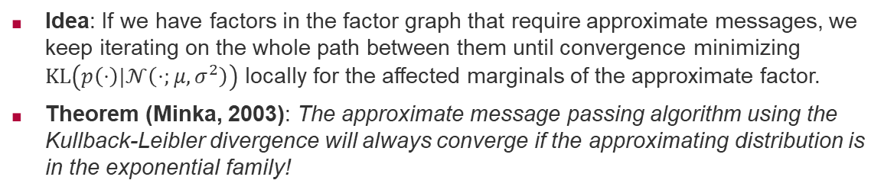
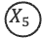
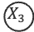

Expectation Propagation
Idea: If we have factors in the factor graph that require approximate messages, we keep iterating on the whole path between them until convergence minimizing $KL\left(p\left(⋅\right)|𝒩\left(⋅;μ,σ^{2}\right)\right)$ locally for the affected marginals of the approximate factor.
Theorem (Minka, 2003): The approximate message passing algorithm using the Kullback-Leibler divergence will always converge if the approximating distribution is in the exponential family!
Tom Minka
1
1
1
$$X_{1}$$
$$X_{2}$$
$$X_{5}$$
8
4
7
8
2
5
$$X_{3}$$
$$X_{4}$$
3
6
iterate until convergence

Slide 14
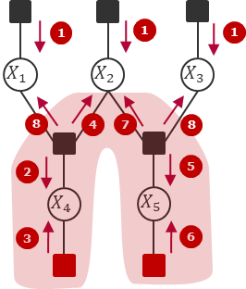
KL Divergence & Alternatives
Numerical Example (discrete):

Slide 15
KL Divergence & Alternatives
Numerical Example (discrete):

Slide 16
KL Divergence & Alternatives
Numerical Example (discrete):

Slide 17
KL Divergence & Alternatives
Numerical Example (discrete):
Compare Convergence with and without Moment Matching:
Without:
With:

Slide 18
KL Divergence & Alternatives
Numerical Example (discrete):
Compare Convergence with and without Moment Matching:
Without: 1 Iteration
With:

Slide 19
KL Divergence & Alternatives
Numerical Example (discrete):
Compare Convergence with and without Moment Matching:
Without: 1 Iteration
With: 7 Iterations

Slide 20
Overview
Questions and Updates
Recap: Main Concepts of Unit 5
Example: KL Divergence
Example: Iterating Approximated Factors
Example: Normalization Constant

Slide 21
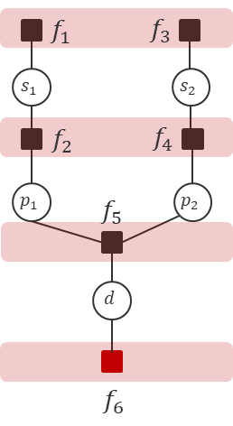
Normalization Constant
Numerical Example (discrete):
(i)
(ii)

Slide 22
Normalization Constant
Numerical Example (discrete):
(i)
(ii)
Apply the Sum-Product-Algorithm WITHOUT any normalization
and obtain unnormalized marginals
(iii)

Slide 23
Normalization Constant
Numerical Example (discrete):
(i)
(ii)
Apply the Sum-Product-Algorithm WITHOUT any normalization
and obtain unnormalized marginals . Then:
(iii)

Slide 24
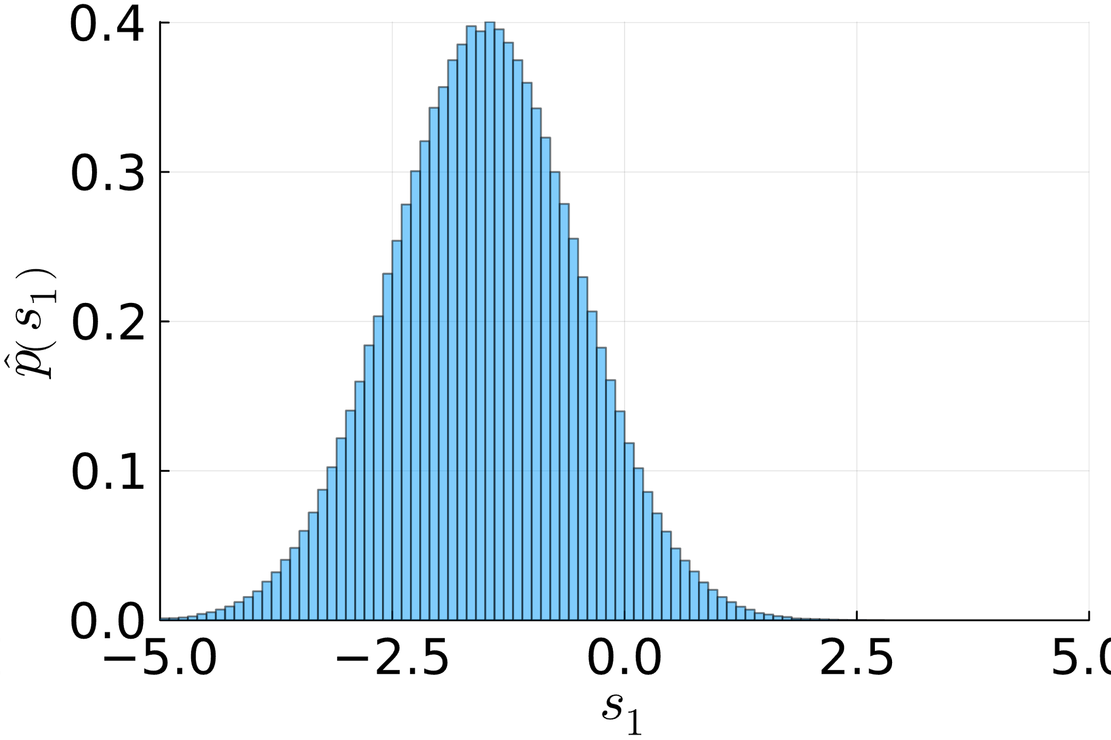
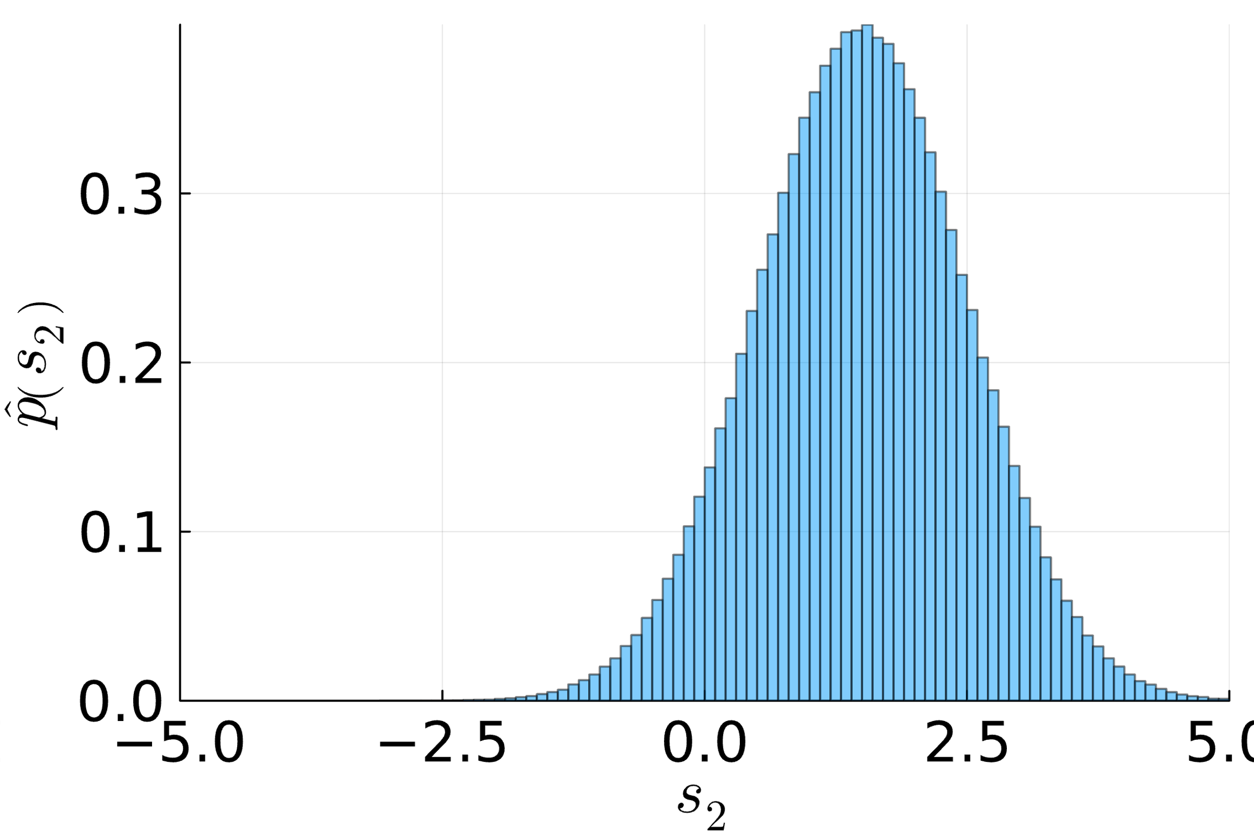
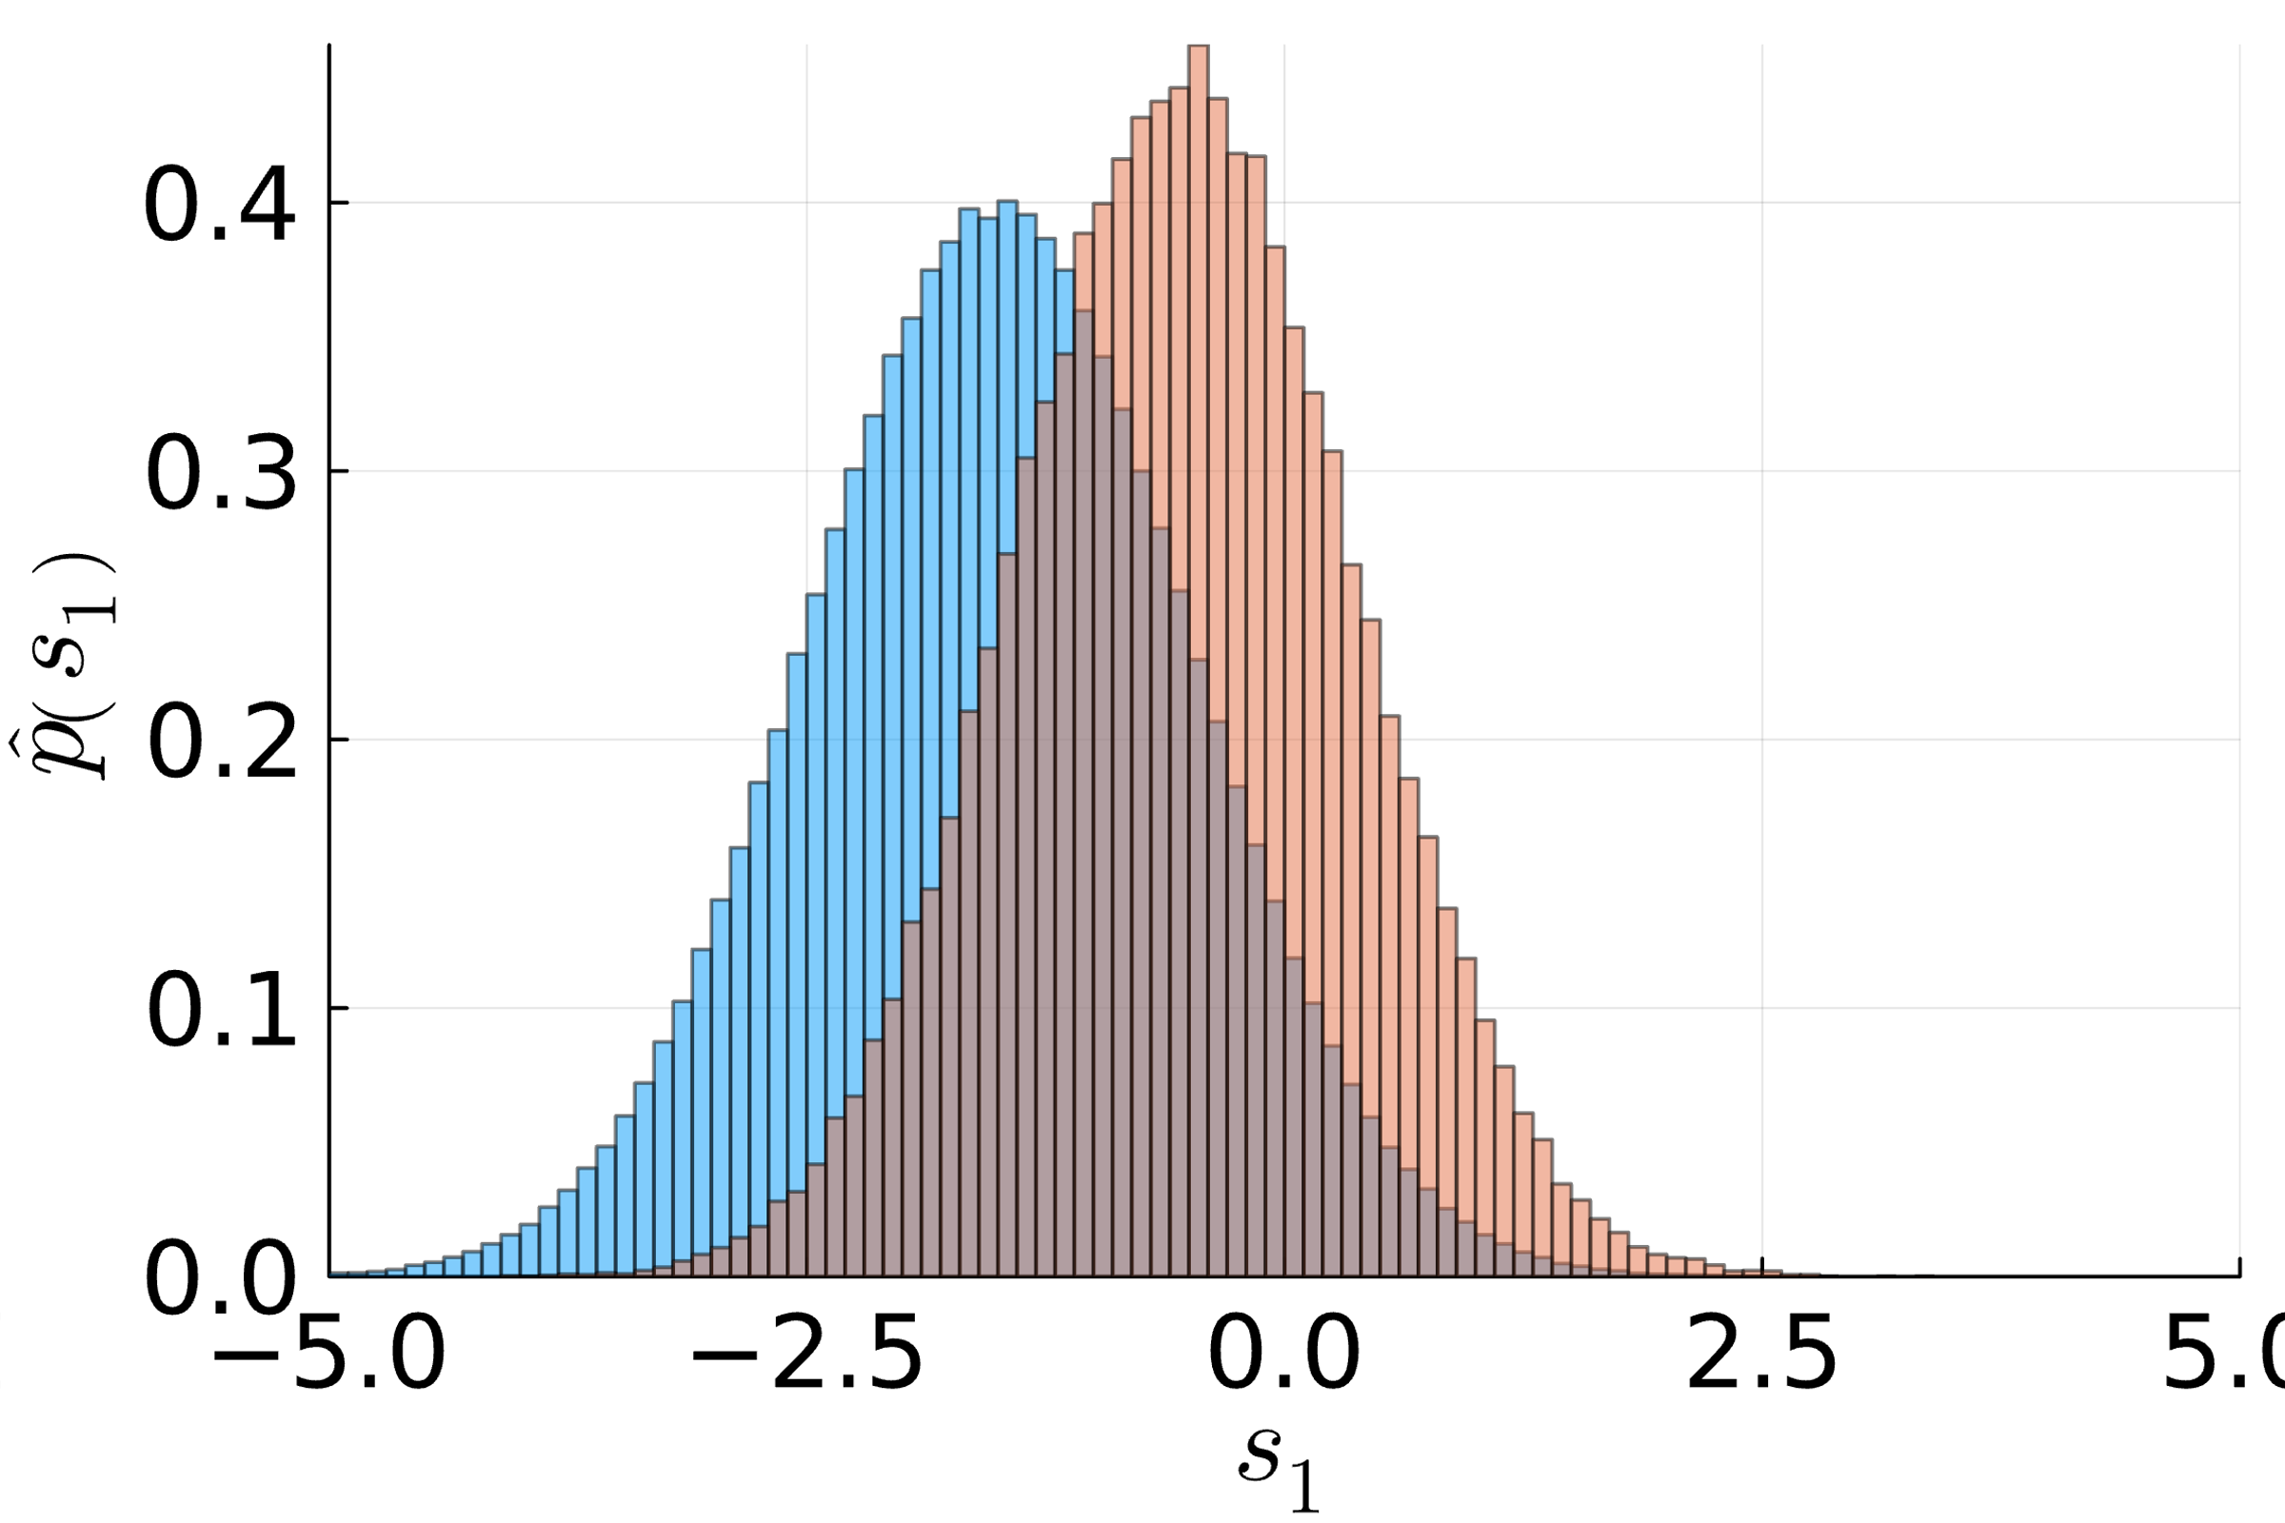
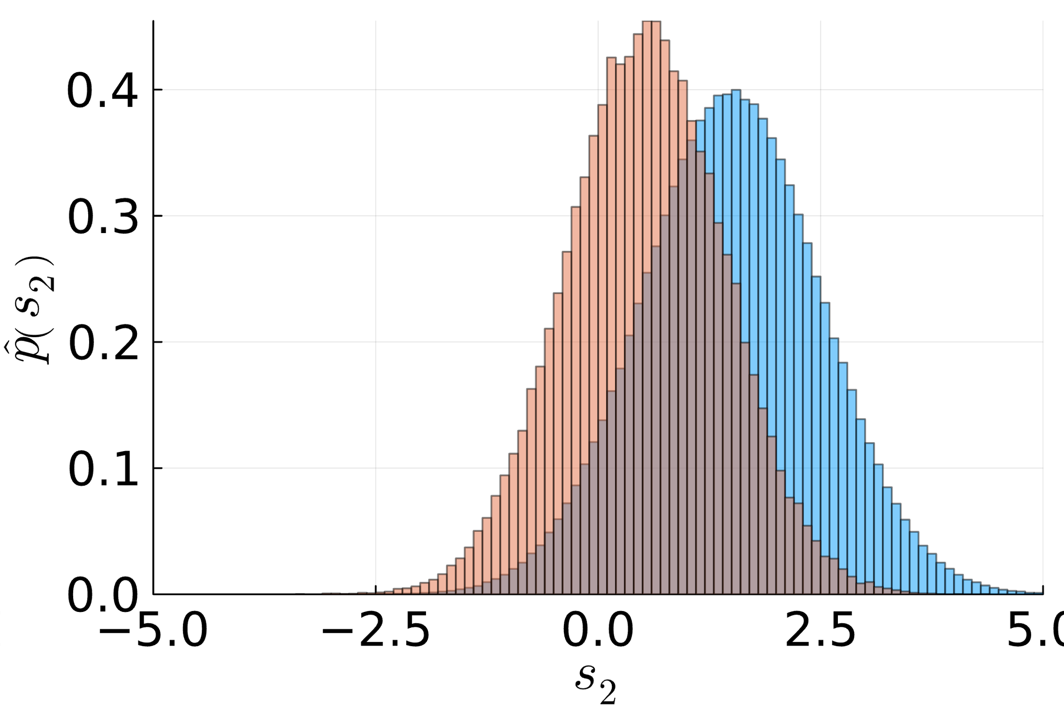
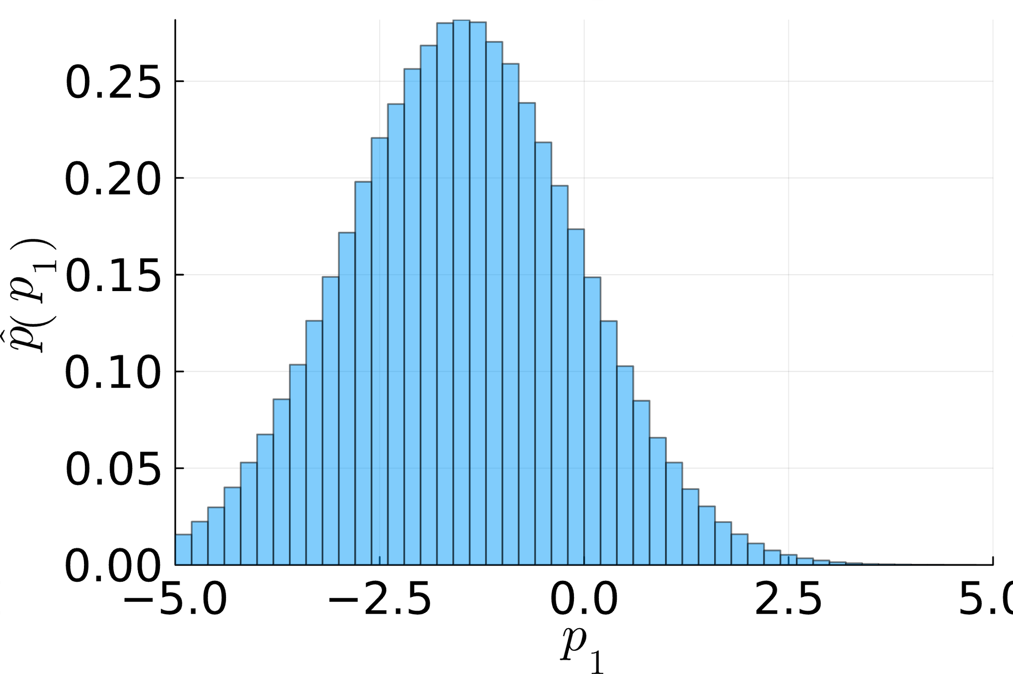
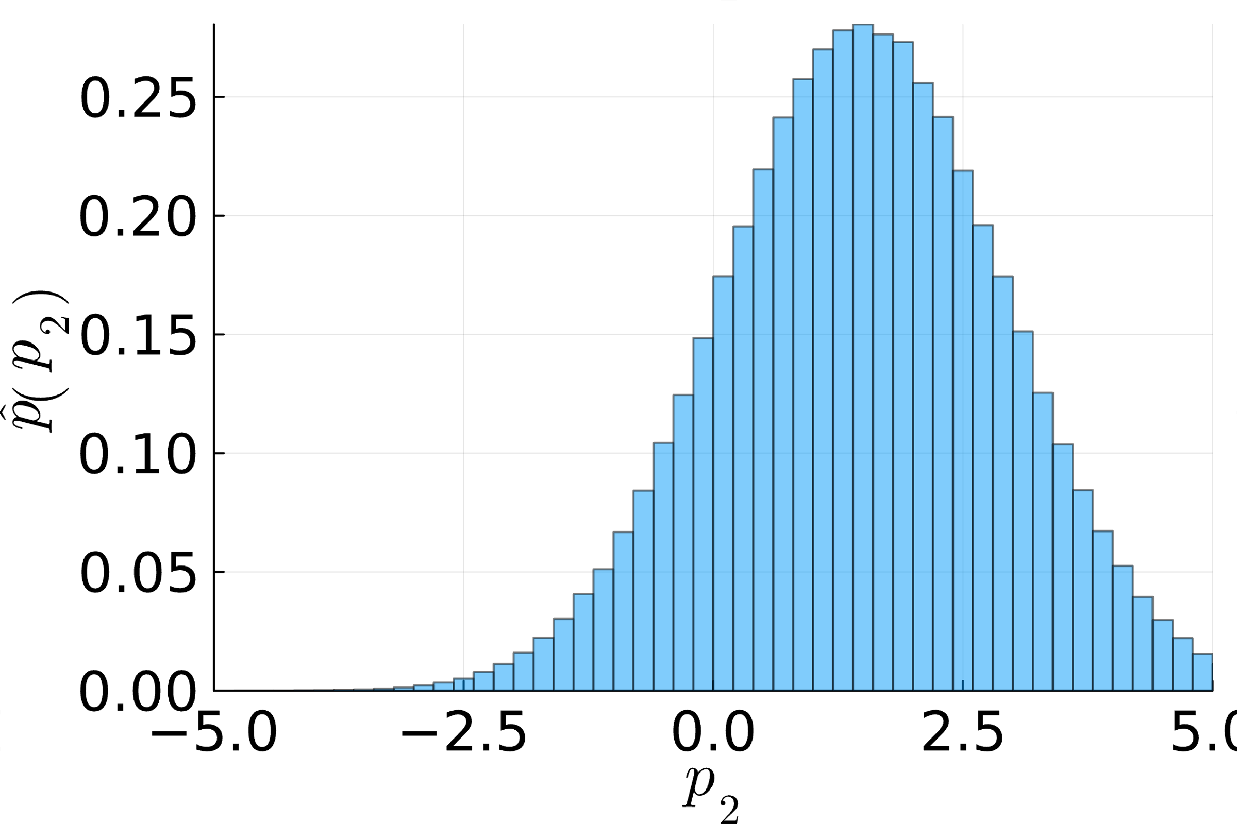
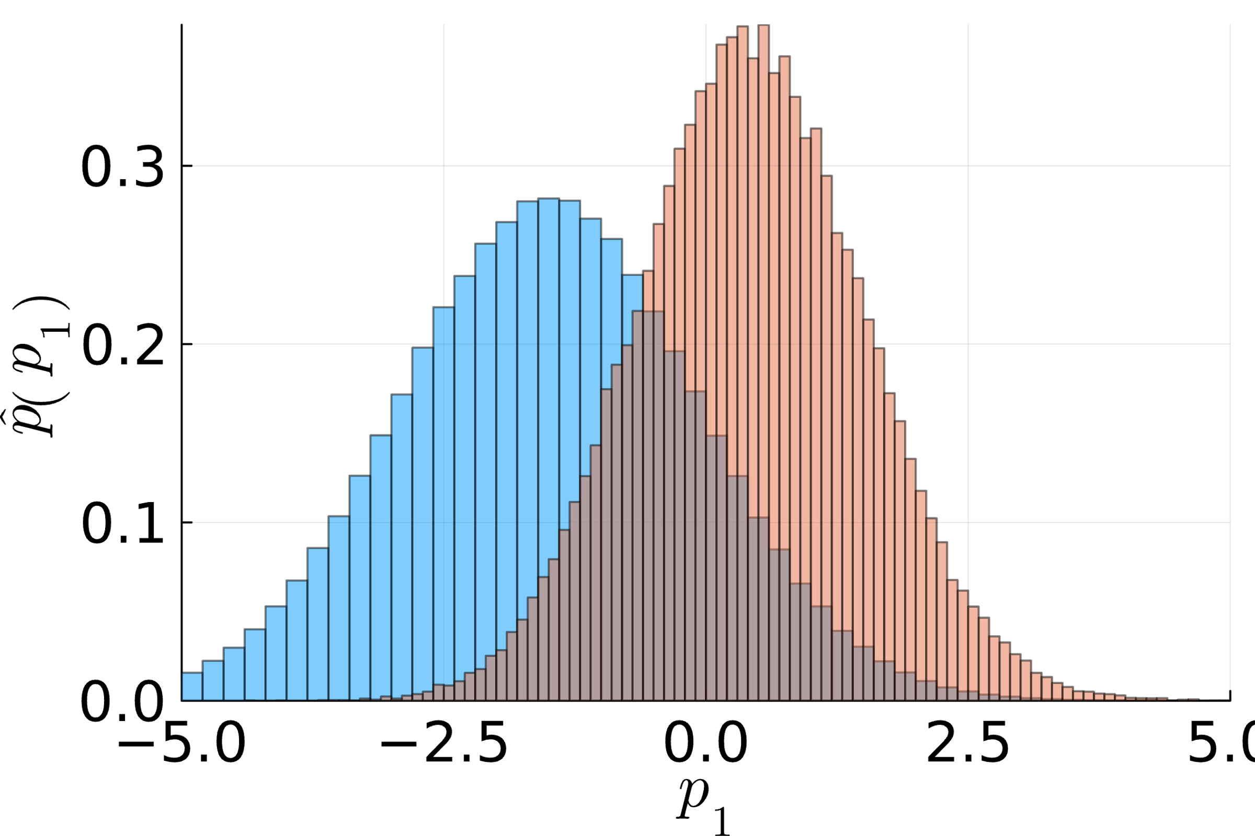
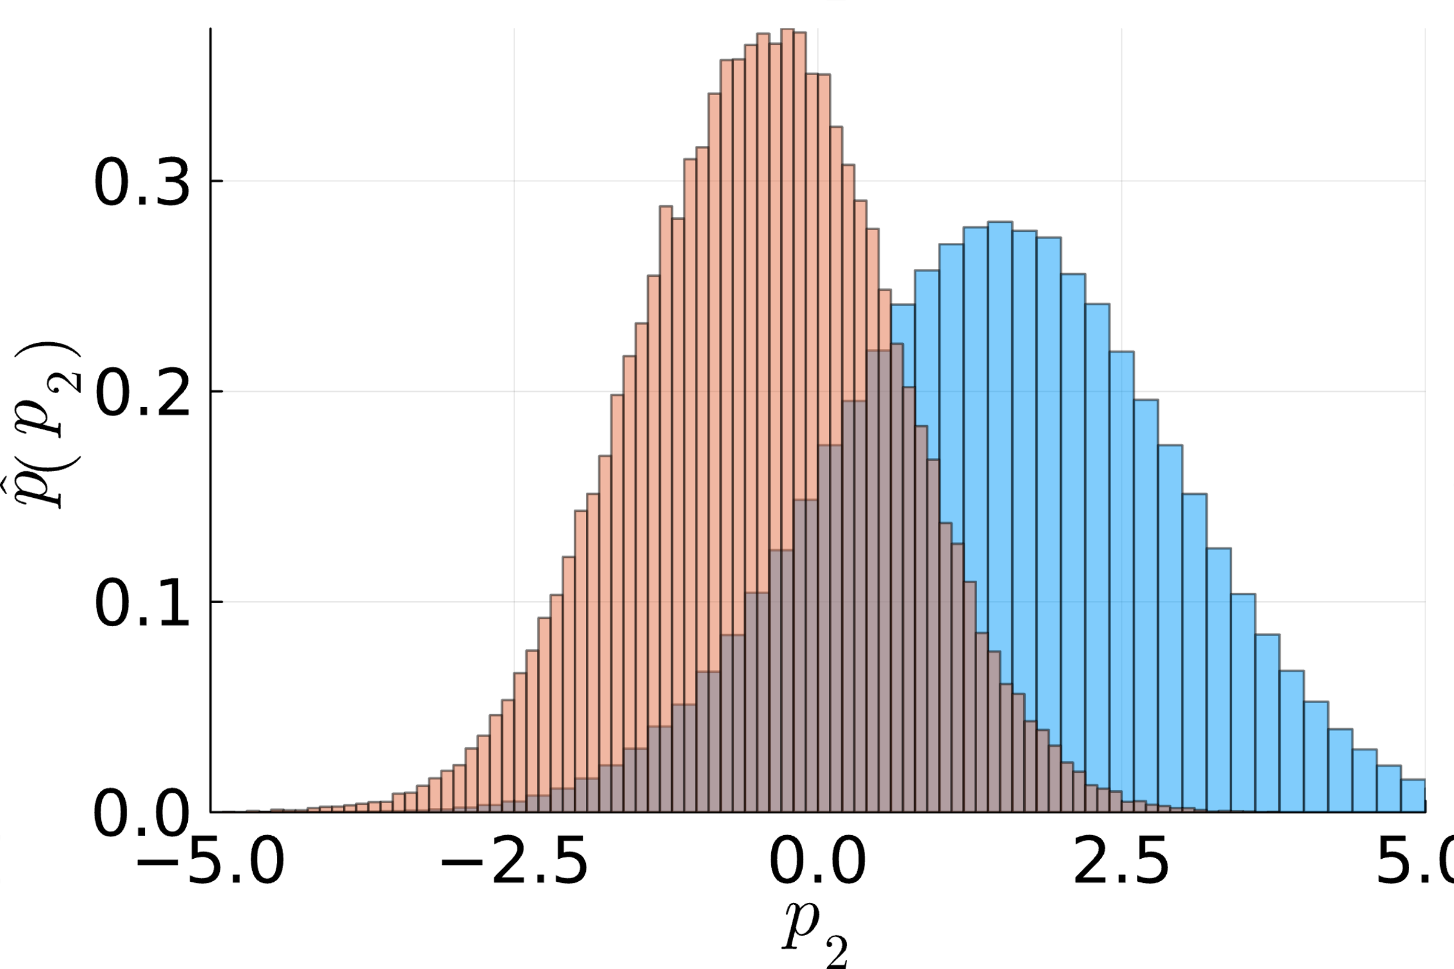
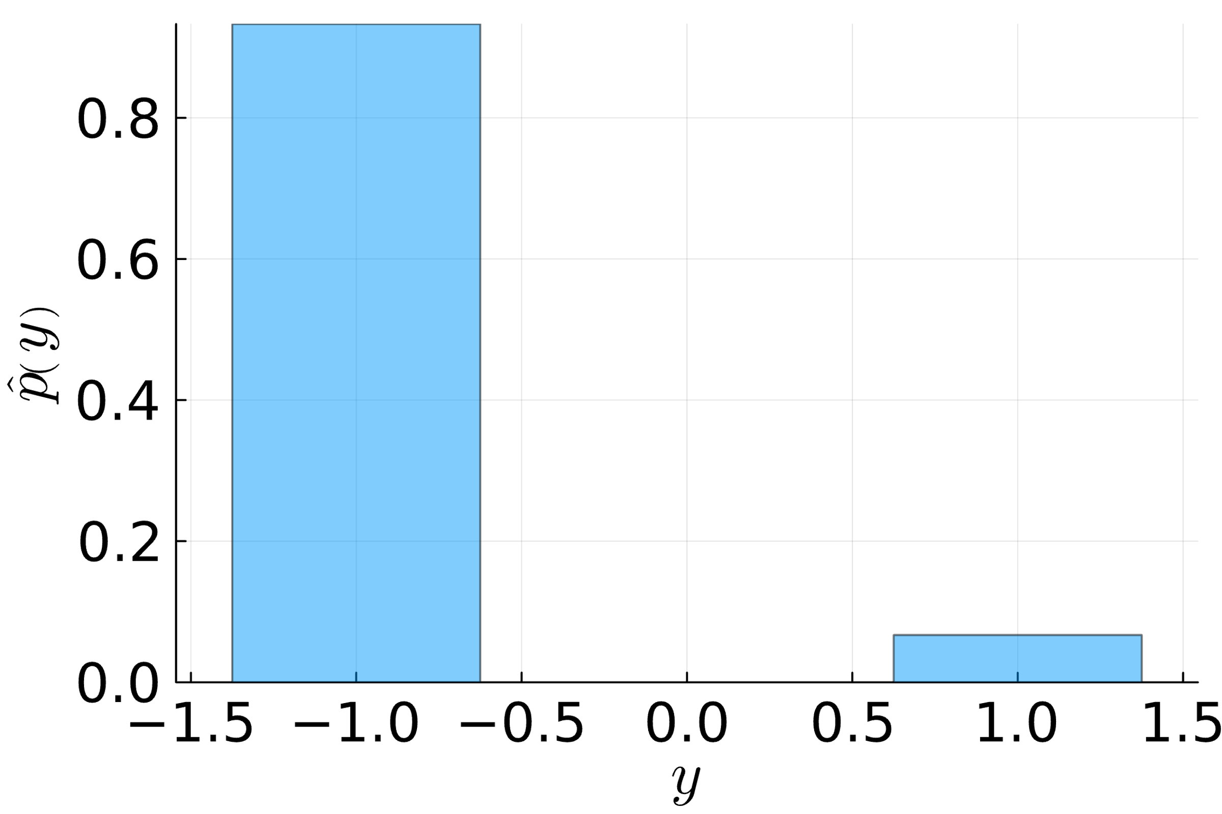
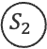
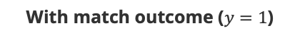
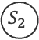
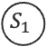
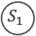


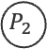
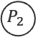
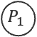
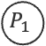
Sampling a Bayesian Network: Example (ctd)
$$𝒩\left(s_{1};μ_{1},σ_{1}^{2}\right)⋅𝒩\left(s_{2};μ_{2},σ_{2}^{2}\right)⋅𝒩\left(p_{1};s_{1},β^{2}\right)⋅𝒩\left(p_{2};s_{2},β^{2}\right)⋅𝕀\left(y\left(p_{1}−p_{2}\right)>0\right)$$
$$μ_{1}≪μ_{2}$$
Without match outcome
With match outcome ($y=1$)
$$S_{1}$$
$$S_{2}$$
$$S_{1}$$
$$S_{2}$$
$$P_{1}$$
$$P_{2}$$
$$P_{1}$$
$$P_{2}$$
$$Y$$
$$Y$$

Slide 25
Weighted Sums of Gaussian Random Variables
Linear Combination (Addition) of Gaussian RVs:
(i)

Slide 26
Weighted Sums of Gaussian Random Variables
Linear Combination (Addition) of Gaussian RVs:
(i)

Slide 27
Weighted Sums of Gaussian Random Variables
Linear Combination (Addition) of Gaussian RVs:
(i)
Multiplication Theorem for Products of Gaussian Densities:
(ii)

Slide 28
Weighted Sums of Gaussian Random Variables
Linear Combination (Addition) of Gaussian RVs:
(i)
Multiplication Theorem for Products of Gaussian Densities:
(ii)

Slide 29
Weighted Sums of Gaussian Random Variables
Linear Combination (Addition) of Gaussian RVs:
(i)
Multiplication Theorem for Products of Gaussian Densities:
(ii)

Slide 30
Summary
Recap I: KL Divergence / Moment Matching / Truncated Gaussians
Recap II: Iterated Sum-Product-Algorithm (Approximate MP)
Recap III: Normalization Constant
Recap IV: Sums of Gaussians

Slide 31
See you next Week!

